Slide 1
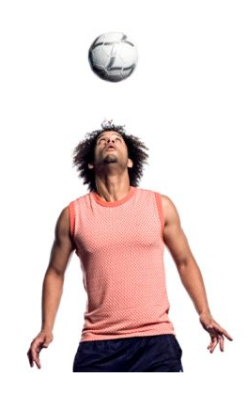
Conservation of Mechanical Energy

Slide 2
Total Mechanical Energy is conserved in cases where an object is moving freely in a gravitational field -friction and air resistance are ignored
Examples:
Ball is thrown up in the air after leaving thrower’s hand
“gravity rides” like roller coaster
pendulum swinging

Slide 3
E_{T} = E_{g} + E_{k}
_{OR}
E_{g1} + E_{k1=} E_{g2} + E_{k2}

Slide 4
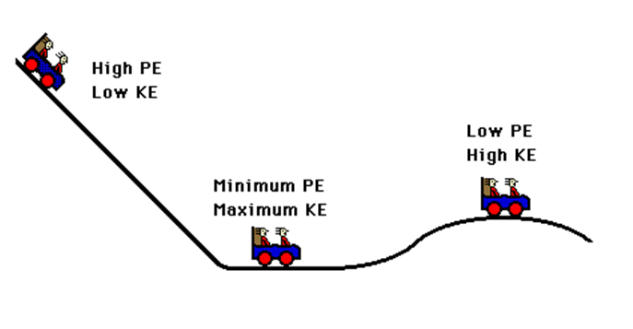
Examples: Roller Coaster
As the car falls it loses ________________ energy and gains ___________ energy
potential
kinetic
potential
As the car rises it loses ________________ energy and gains ___________ energy
kinetic
The SUM of the kinetic energy and potential energy is _______________.
constant

Slide 5
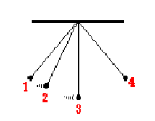




Example 2: A Simple Pendulum
Assume the pendulum is released from rest from position 1
0 J
6 J
2 J
Energy is converted between Potential Energy and Kinetic Energy but the TOTAL ENERGY is CONSTANT!!

Slide 6
Problem: A 0.550 kg ball is thrown down from a cliff 30.0 m high with a speed of 5.00 m/s. Assume air resistance is neglible.
Find:
a) The ball’s initial kinetic, gravitational potential and total
mechanical energy.
b) Find the ball’s potential energy at a height of 10.0 m
above the ground and it’s kinetic energy at that height.
c) Find the ball’s speed just before it hits the ground.
Ans: 1.a) E_{k1}=6.88 J, E_{g1}=162 J E_{T}=169 J
b) E_{g2}= 54.0 J, E_{k2}= 115J
c) v_{final} = 24.8 m/s

